Slide 1
Energy and Economic Activities
Hung Nguyen, Mariah Szabo

Slide 2
Topics
Energy Production - How much primary energy a country extracts from nature
Energy Supply - delivery of energy to the point of consumption - mainly fossil field, additionally nuclear power and renewable sources
Energy Consumption - The use of energy or power of a country by making use of its supply
GDP - Monetary measure of the market value of all the goods and services produced and sold by countries
Population - All of the inhabitants of a particular country
CO2 Emissions - Carbon dioxide emissions - mainly from fossil fuels, although CO2 can be emitted from other sources

Slide 3
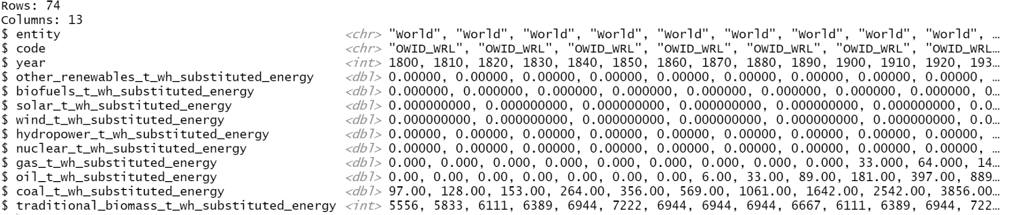
Energy_Consumption.csv
Electric_Consumption – UN; contains information on energy consumption

Slide 4
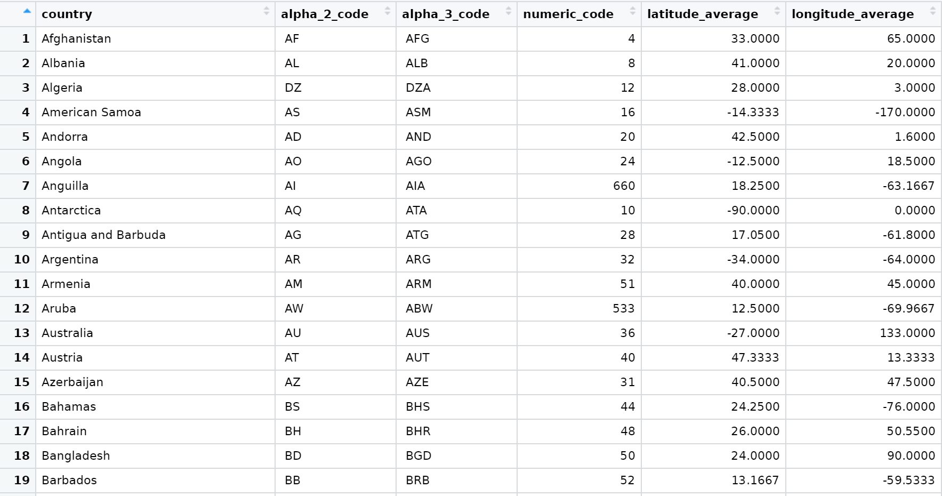
Codes_and_Coordinates.csv
UN; contains different codes, names, and coordinates of each country

Slide 5
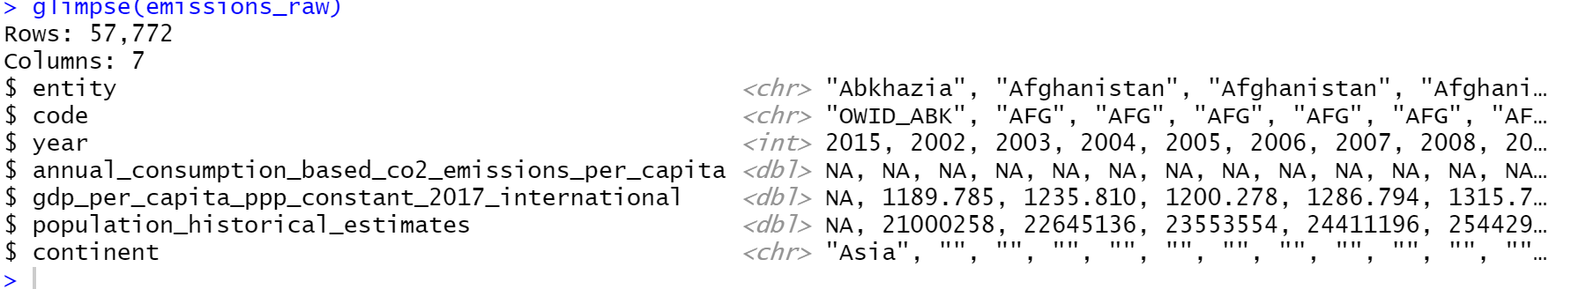
CO2_Emissions.csv
Our World in Data; contains information on CO2 emissions and economic data

Slide 6
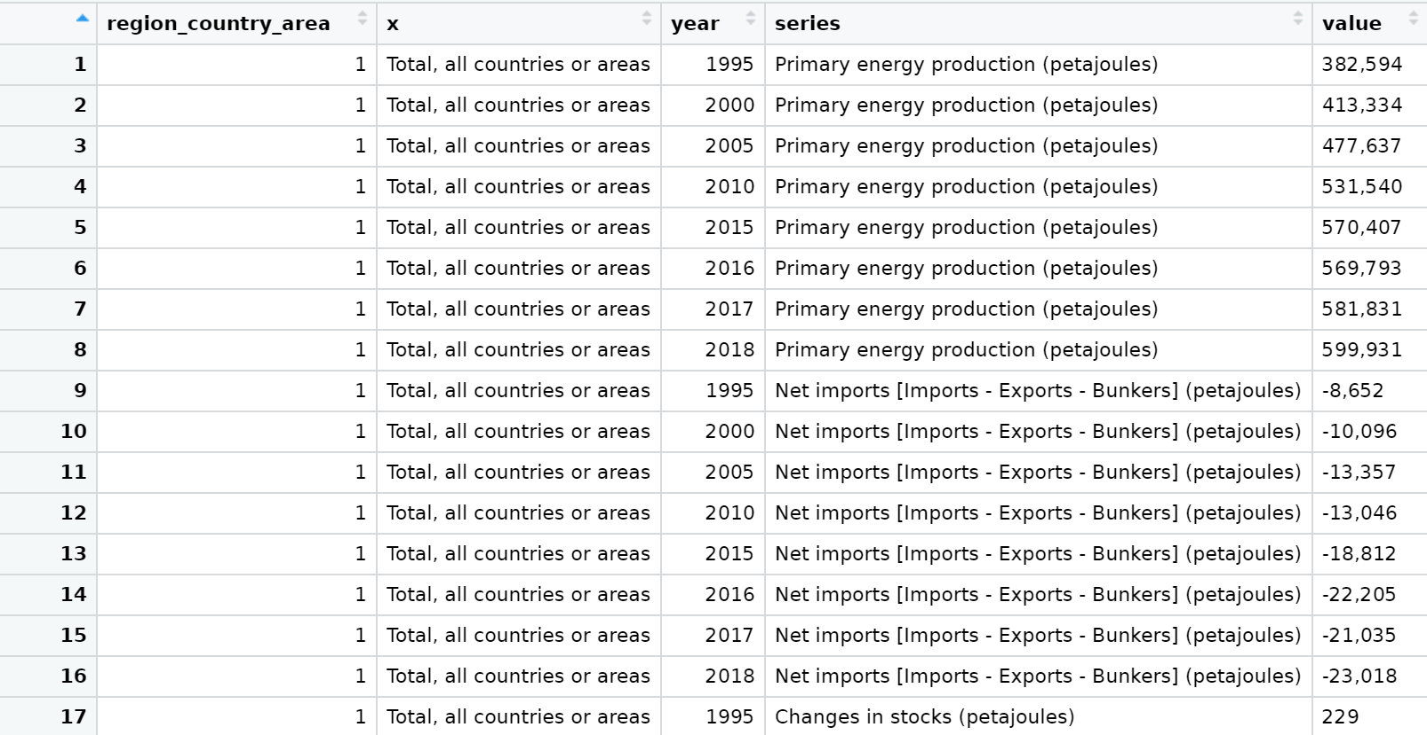
Energy_Production.csv
UN; contains information on energy production

Slide 7
World_Energy.csv
Our World in Data; contains information on energy production sources by year

Slide 8
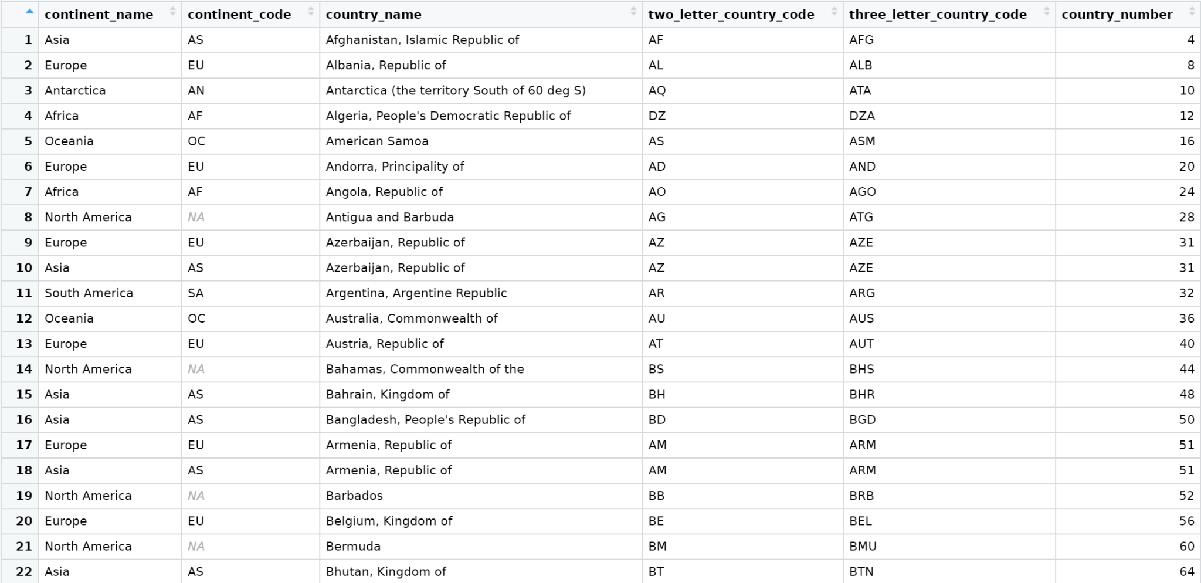
Country_Continent.csv
https://datahub.io/JohnSnowLabs/country-and-continent-codes-list · GitHub

Slide 9
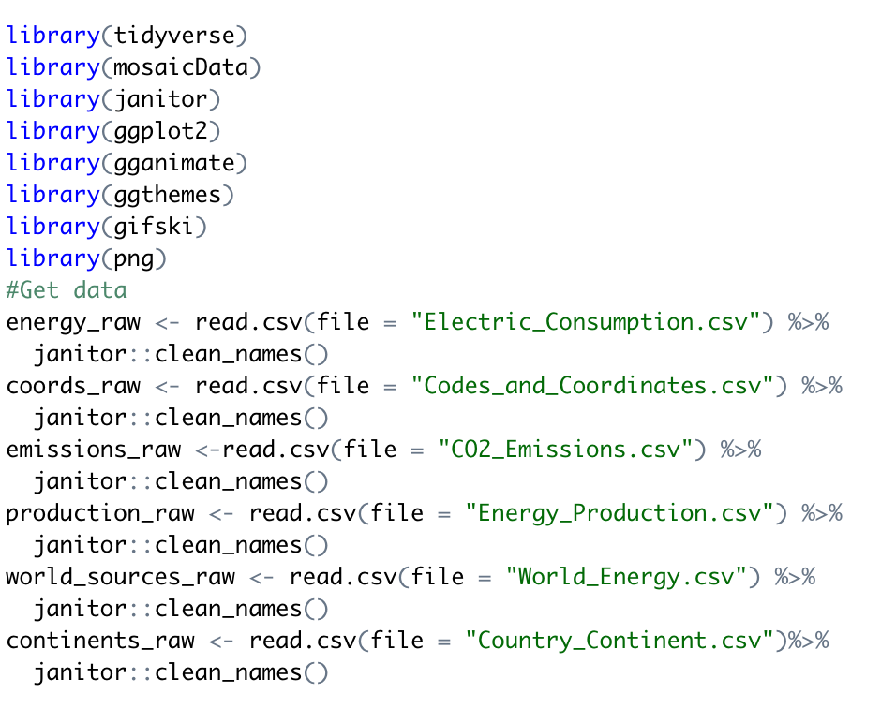
Importing Data

Slide 10
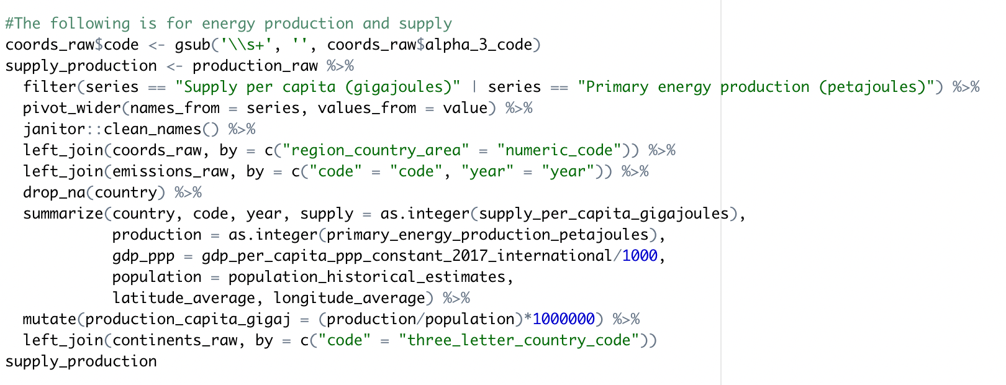

Energy Production Data Wrangling

Slide 11
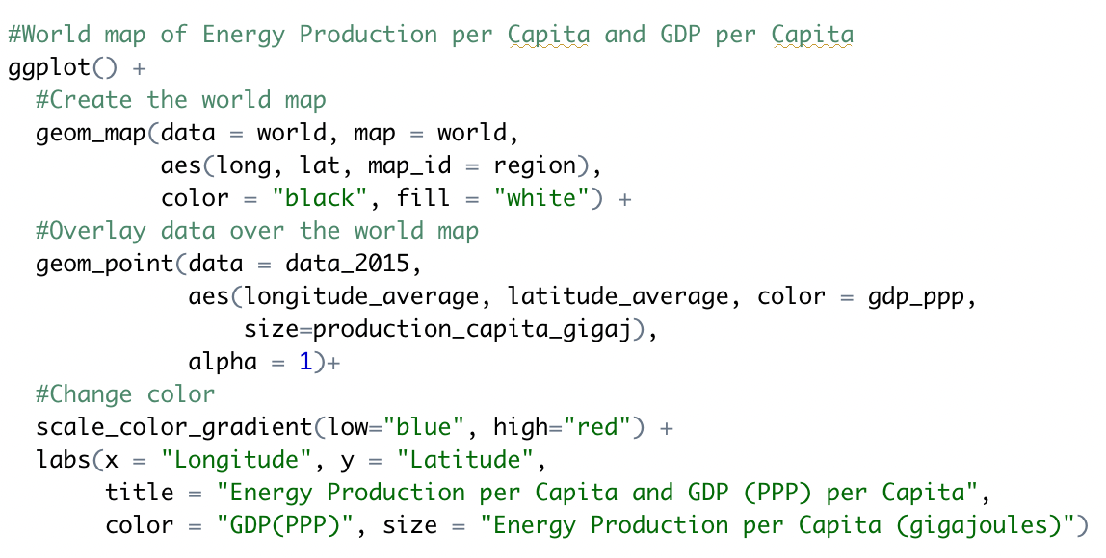
Creating World Map for Energy Production

Slide 12
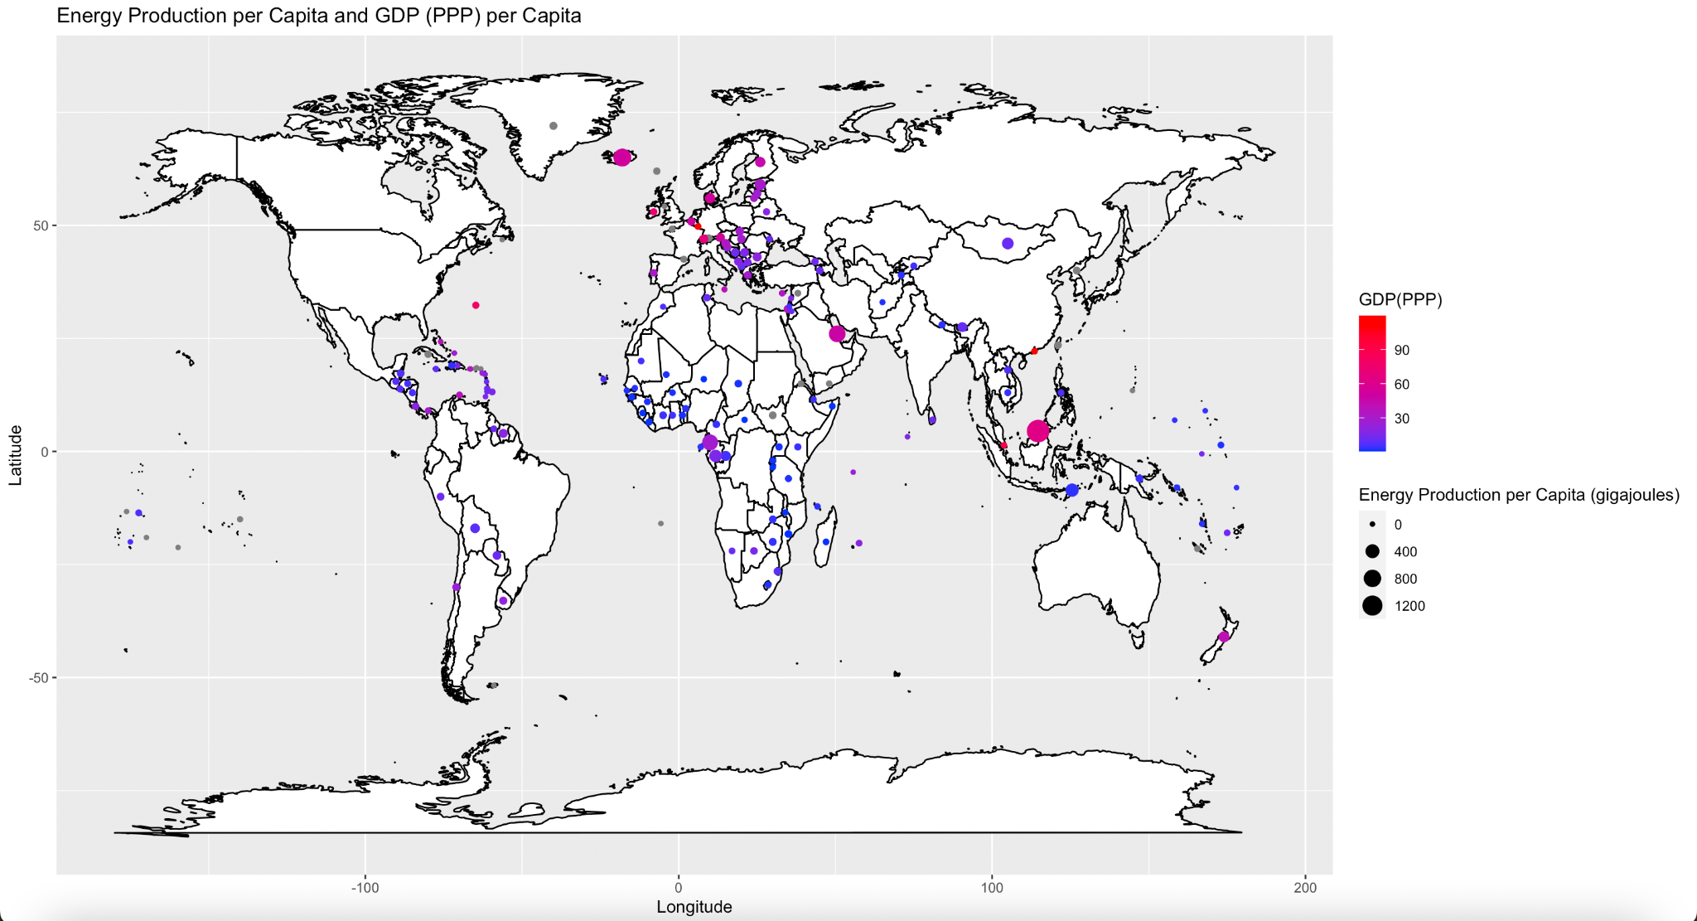

Slide 13
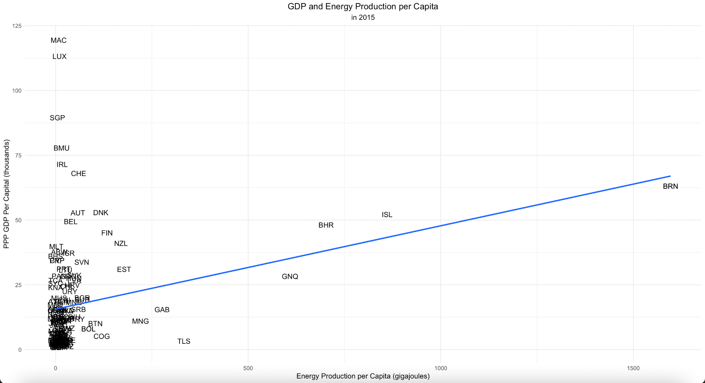
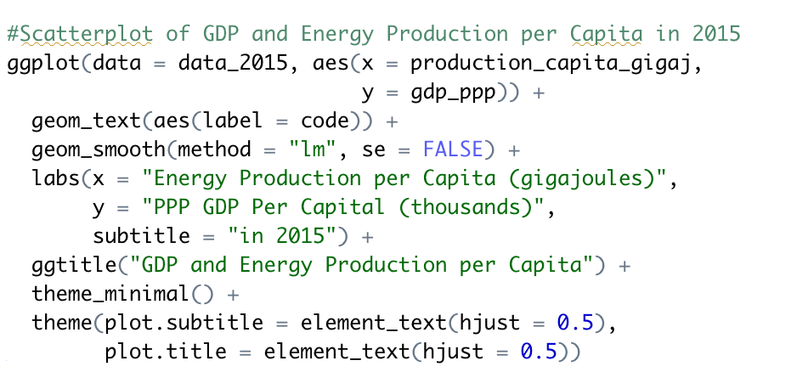

Slide 14
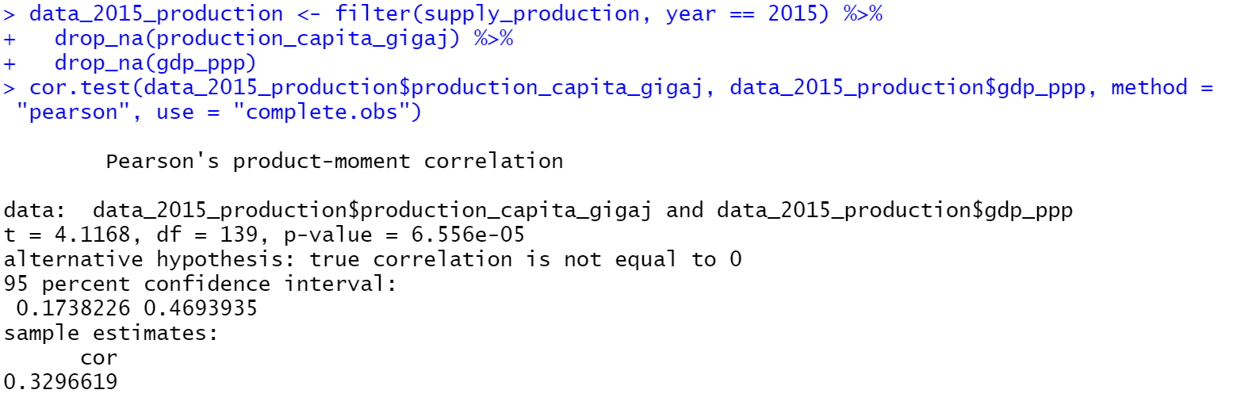
Correlation Test

Slide 15
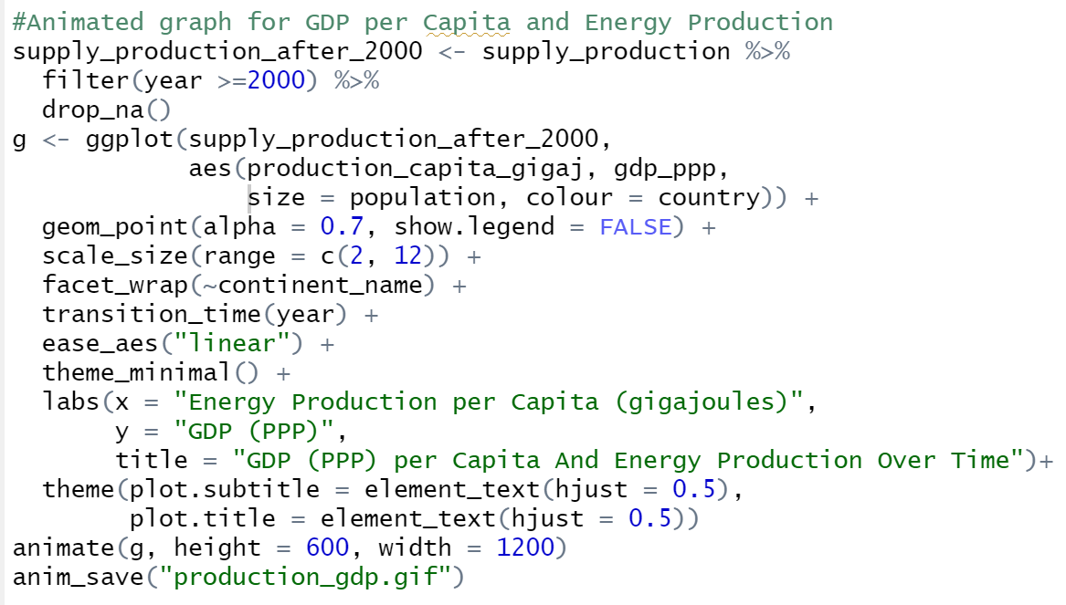
Creating an Animated Graph

Slide 16
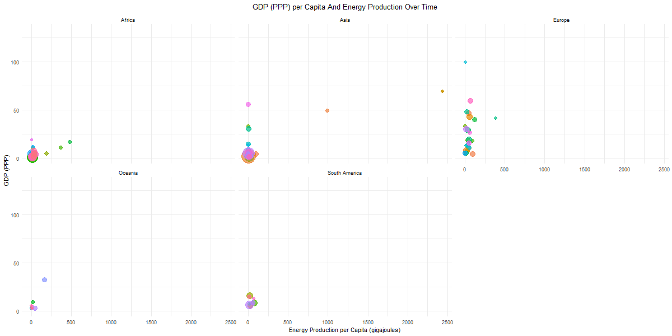

Slide 17
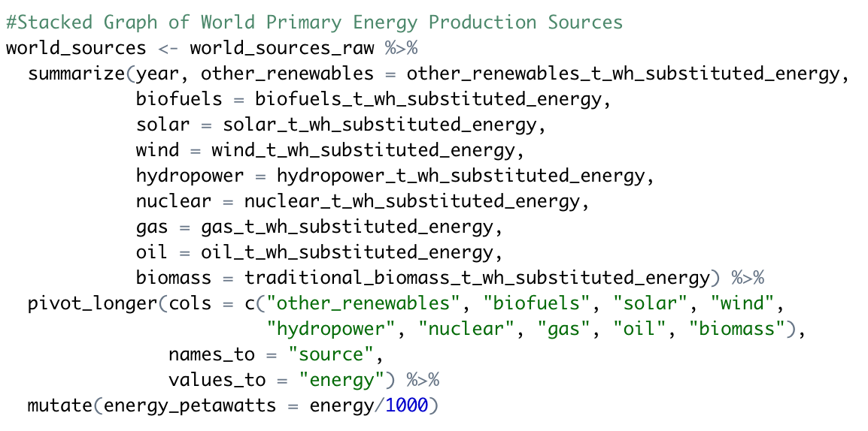
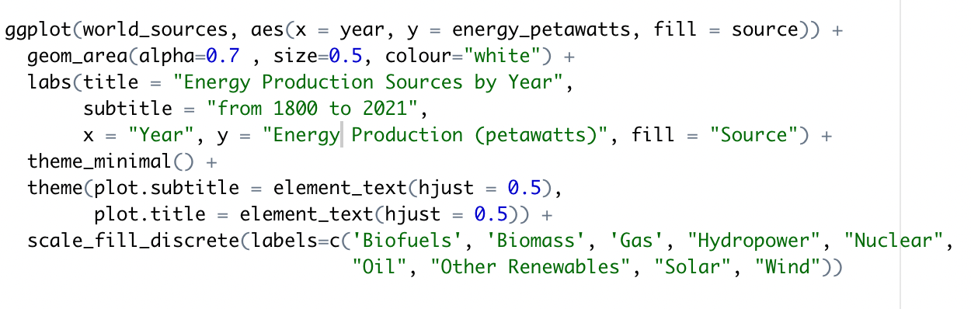
Creating a Stacked Graph of Energy Production Sources

Slide 18
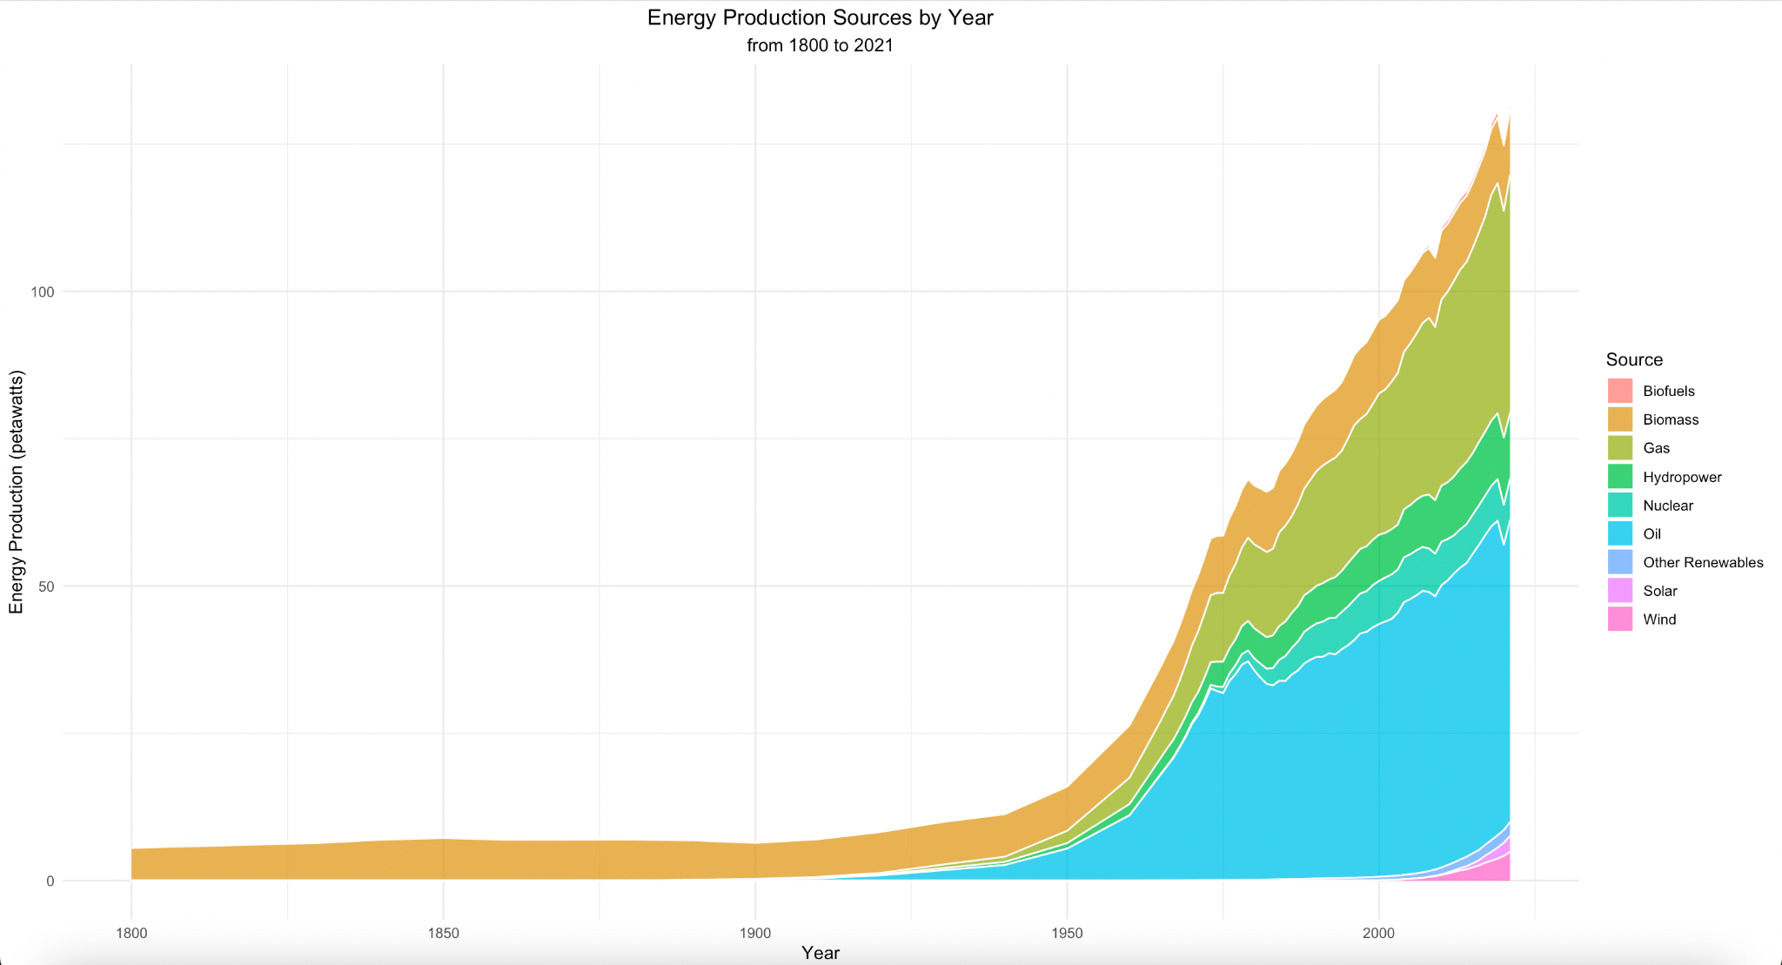

Slide 19
Energy Supply Data Wrangling

Slide 20
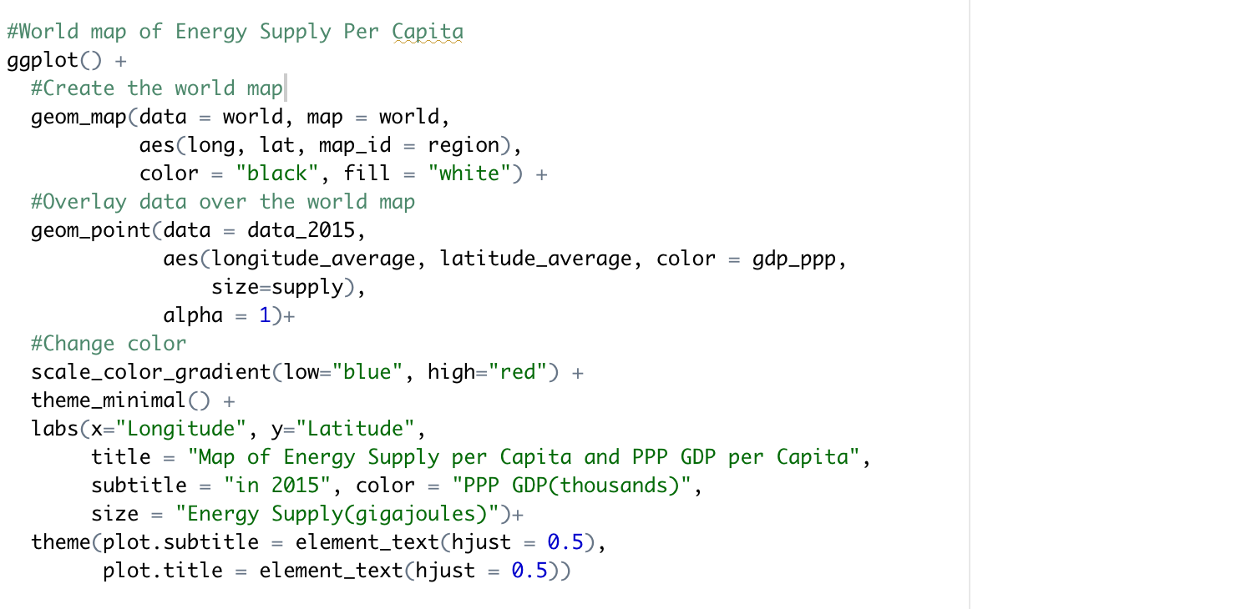
Creating World Map for Energy Supply

Slide 21
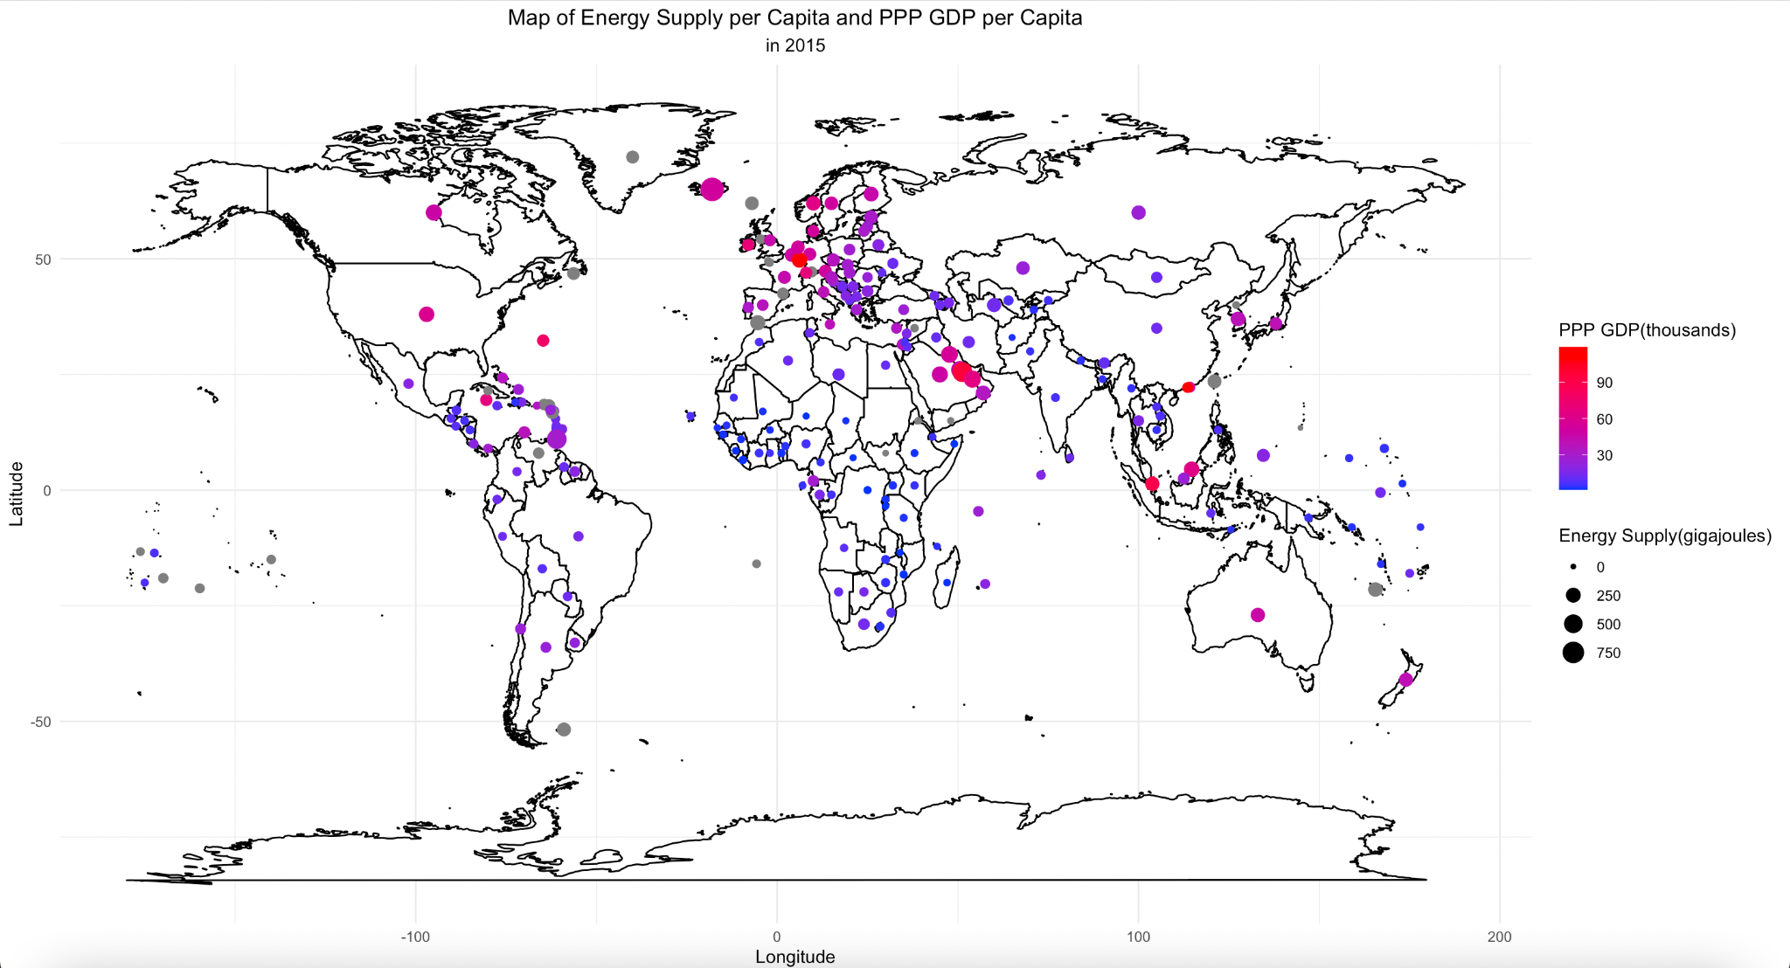

Slide 22
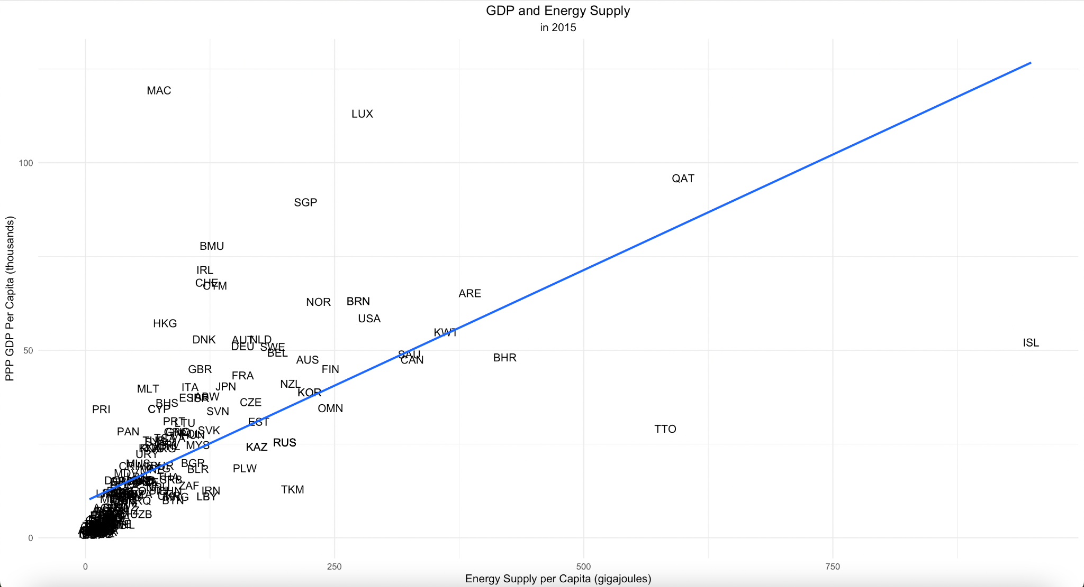
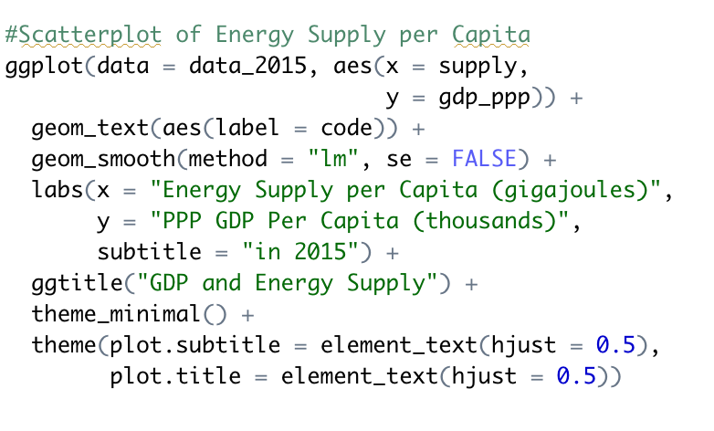

Slide 23
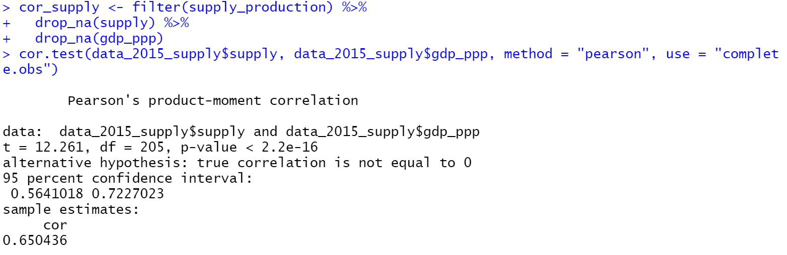
Correlation Test

Slide 24
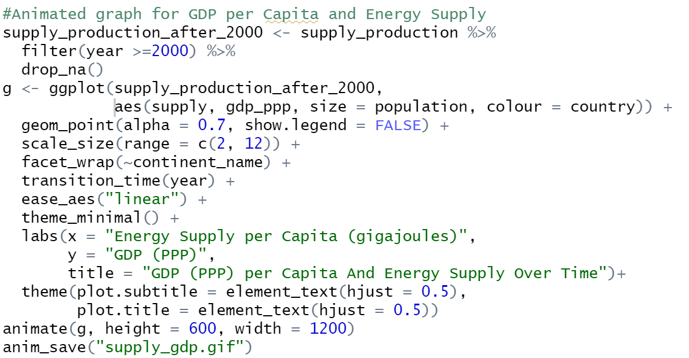
Creating an Animated Graph

Slide 25
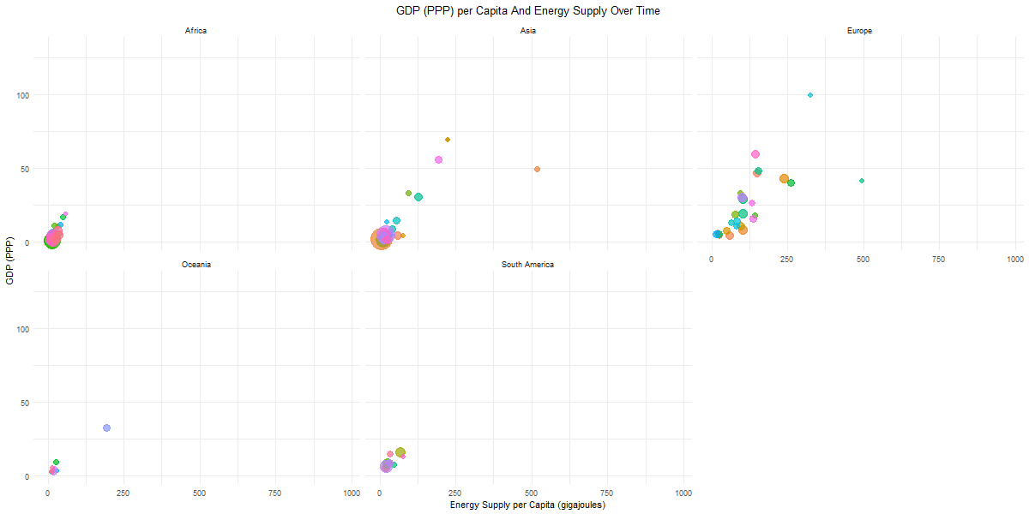

Slide 26
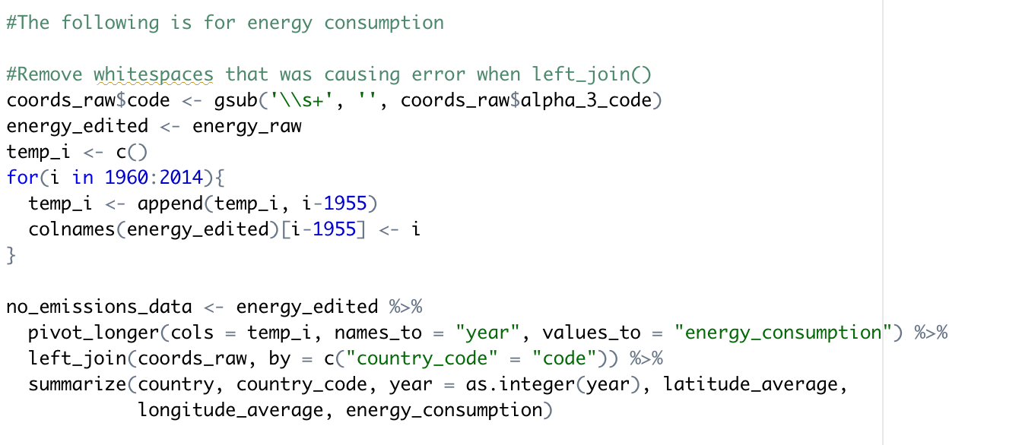
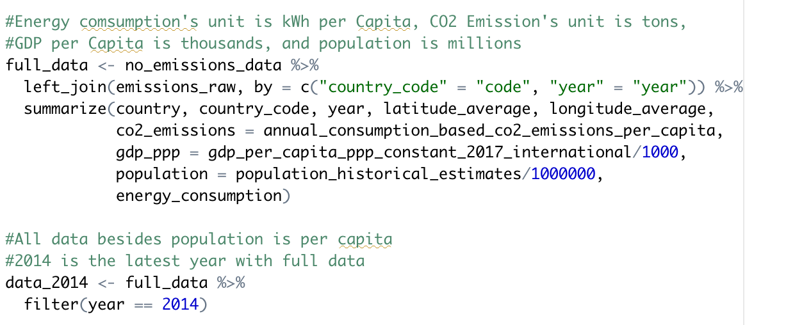
Energy Consumption Data Wrangling

Slide 27
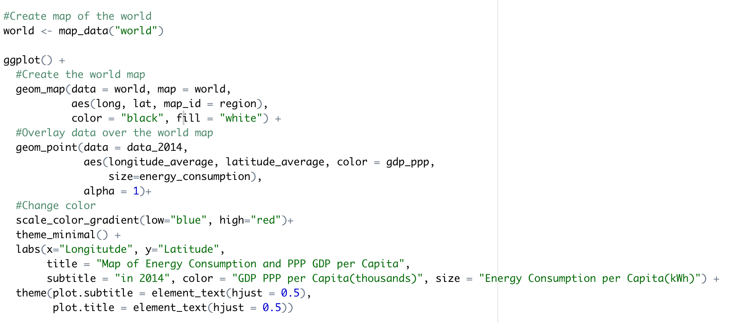
Creating World Map for Energy Consumption

Slide 28
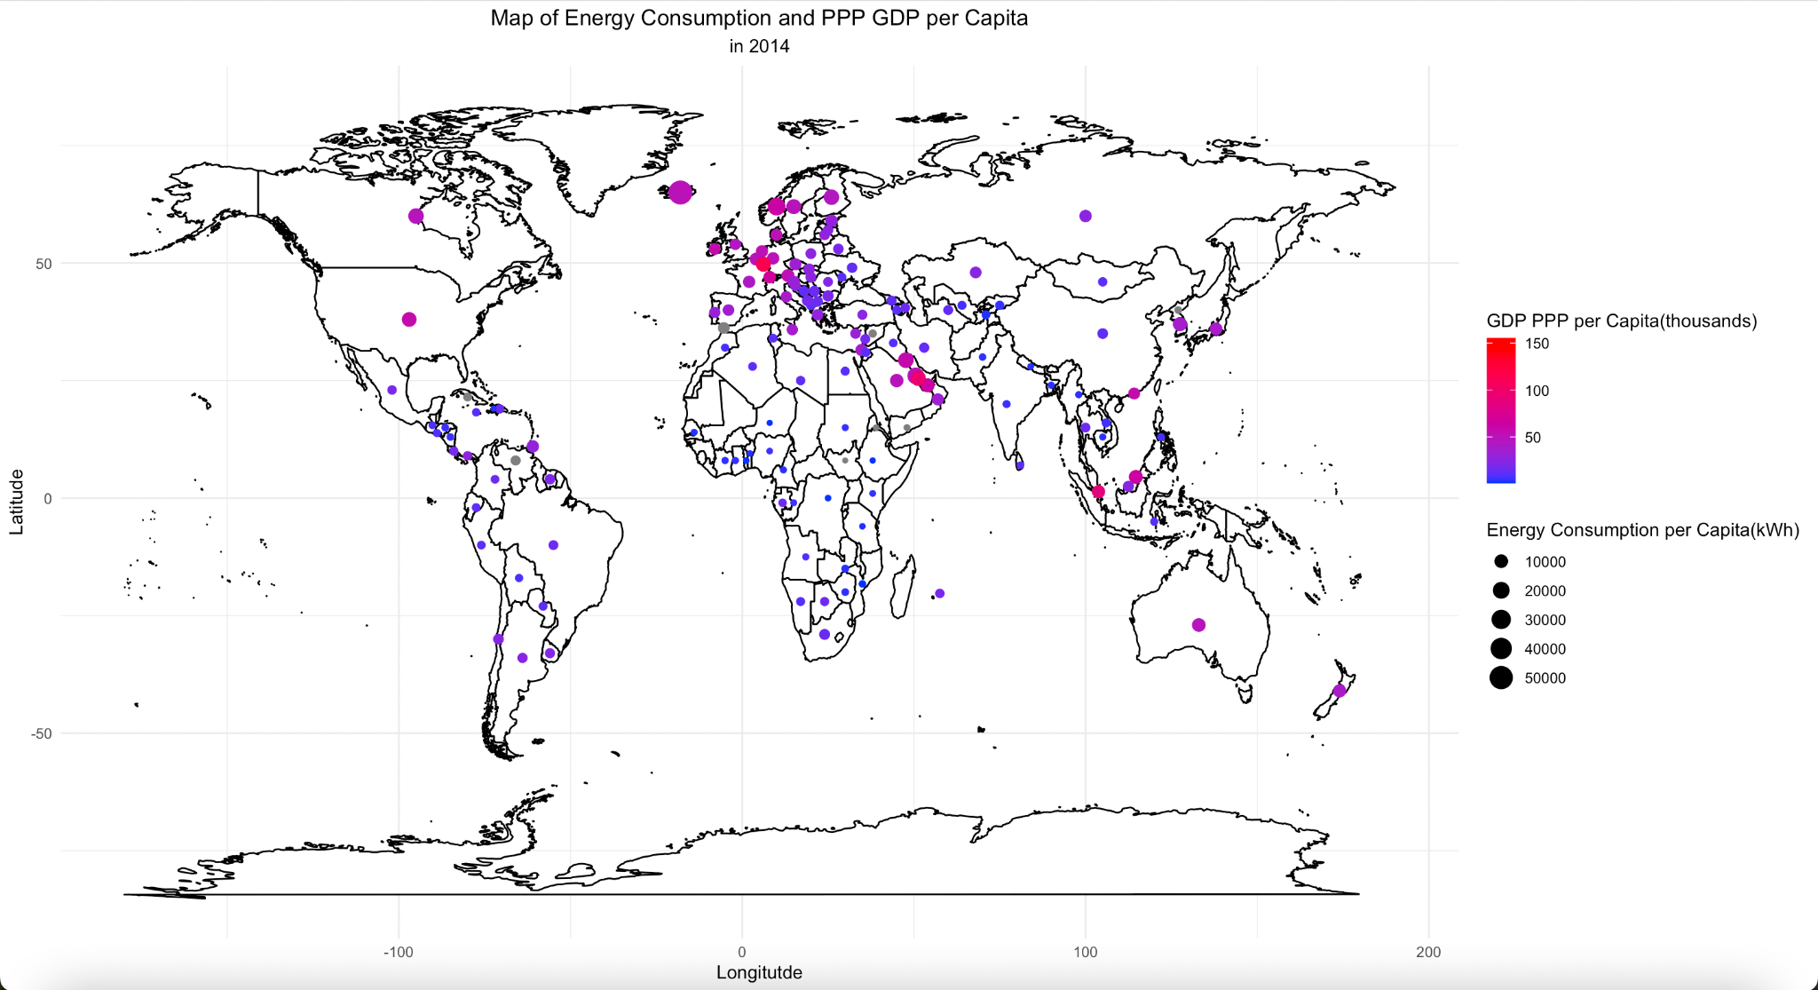

Slide 29
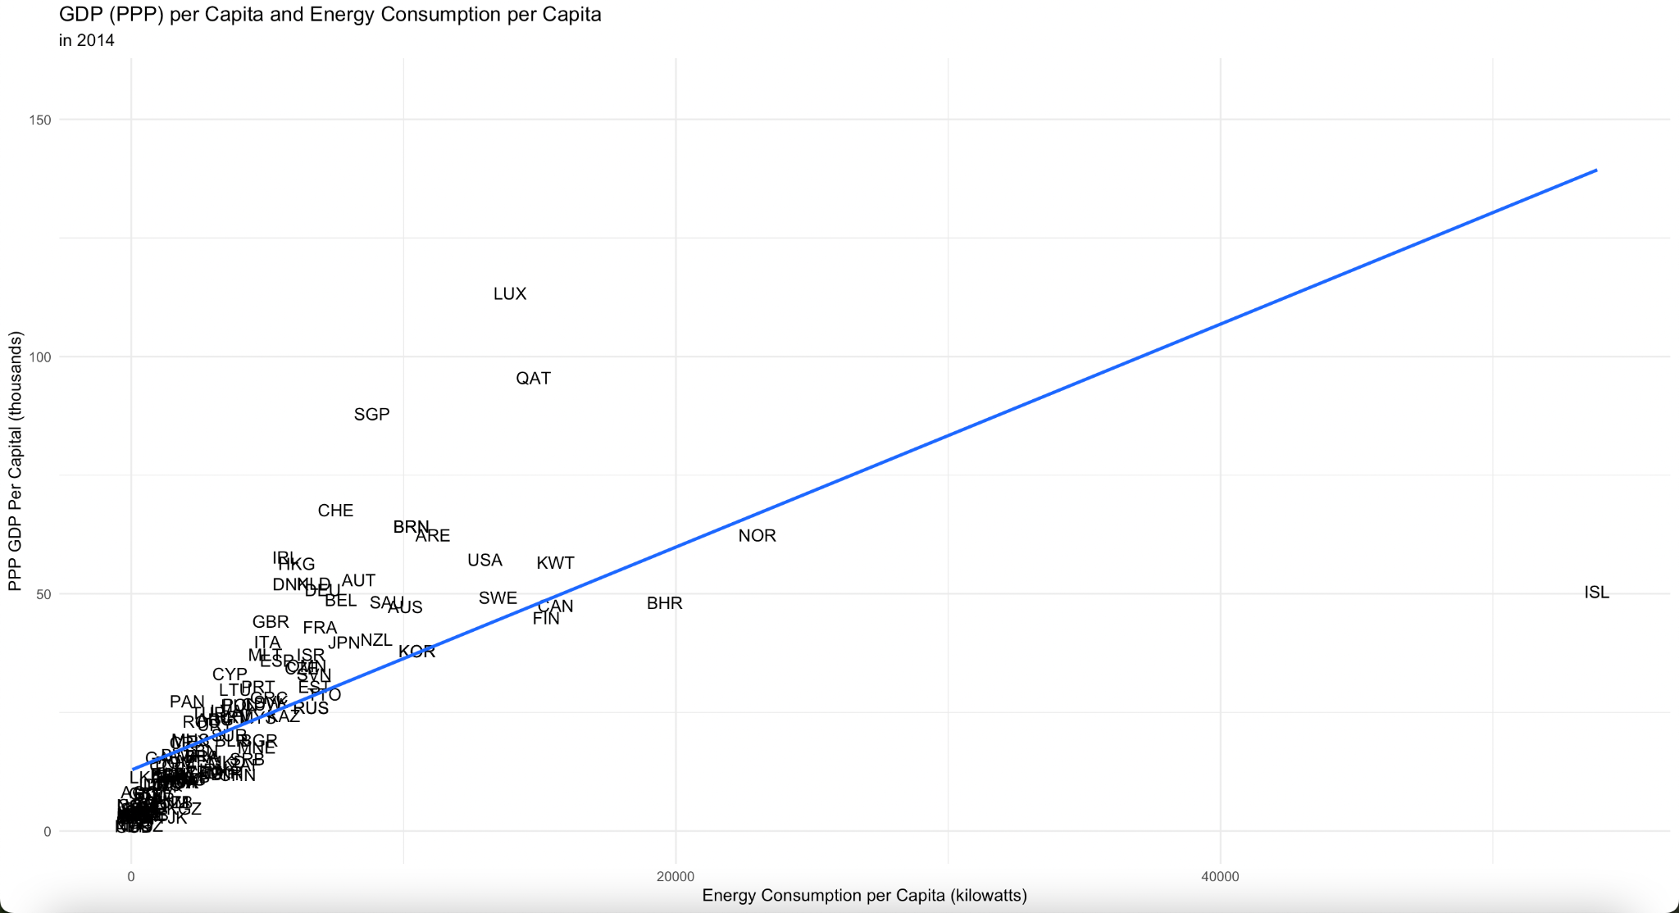
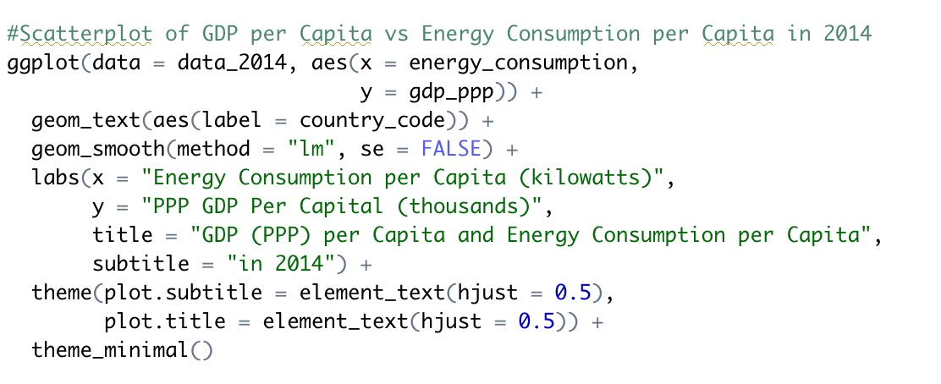

Slide 30
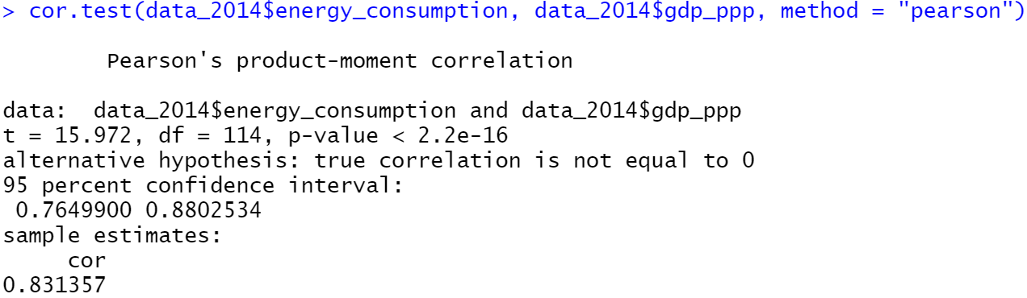
Correlation Test

Slide 31
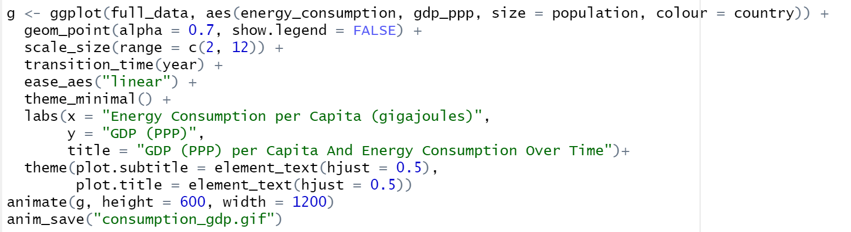
Creating an Animated Graph

Slide 32
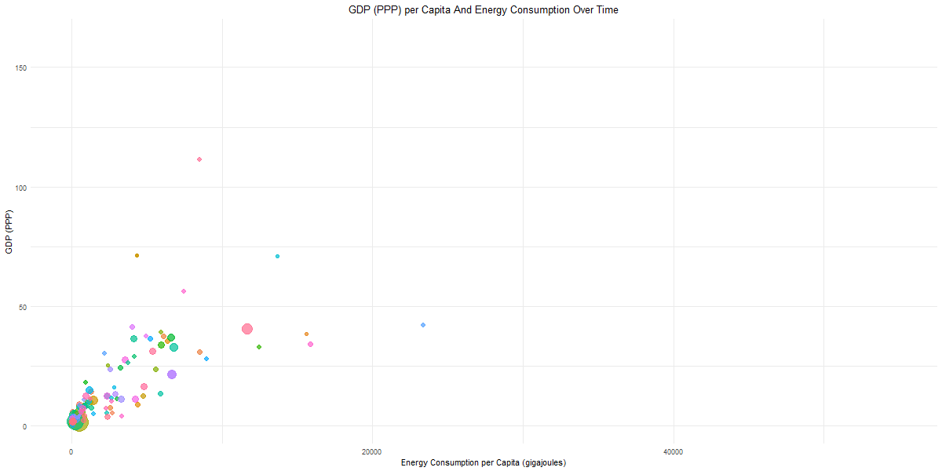

Slide 33
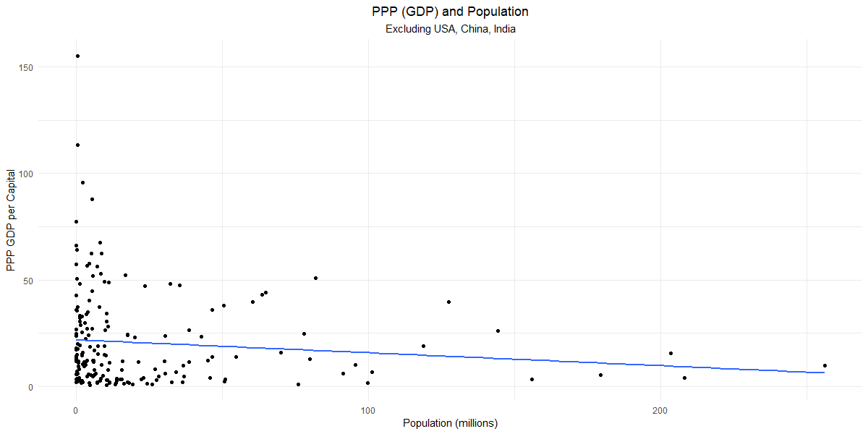
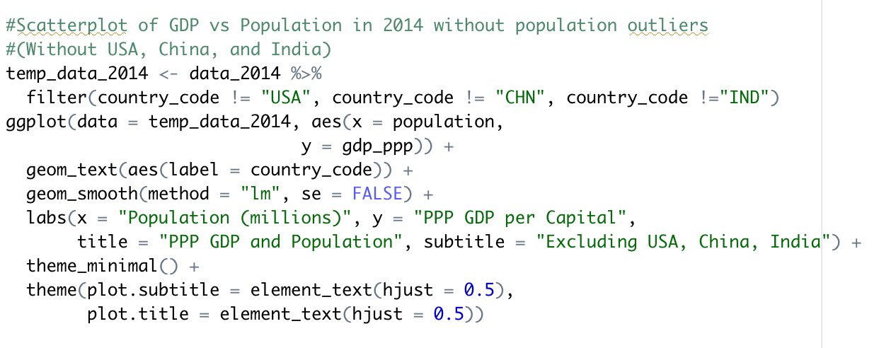

Slide 34
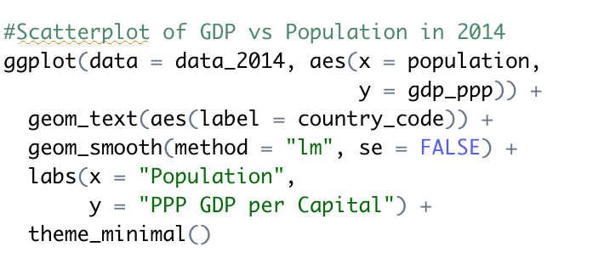
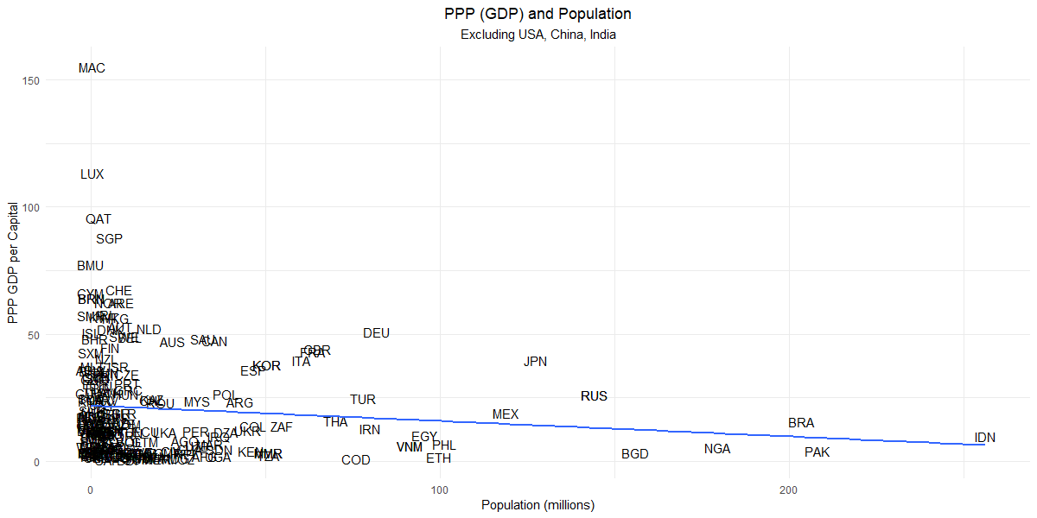

Slide 35
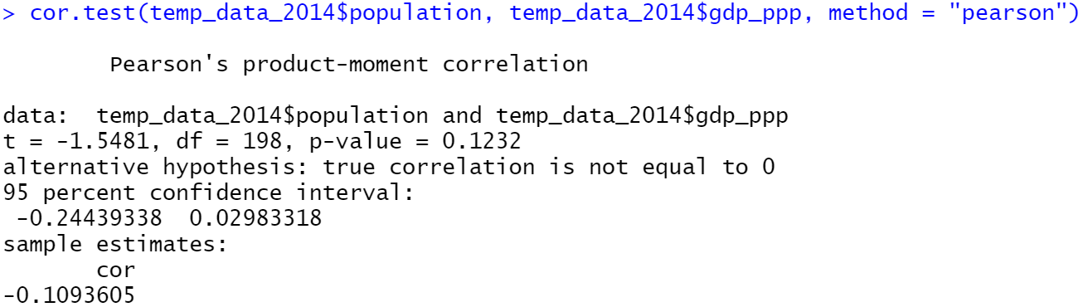
Correlation Test

Slide 36
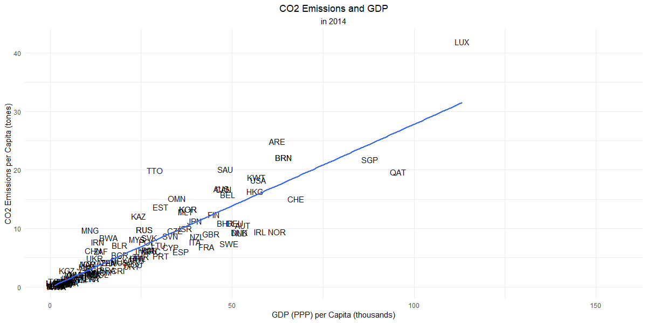
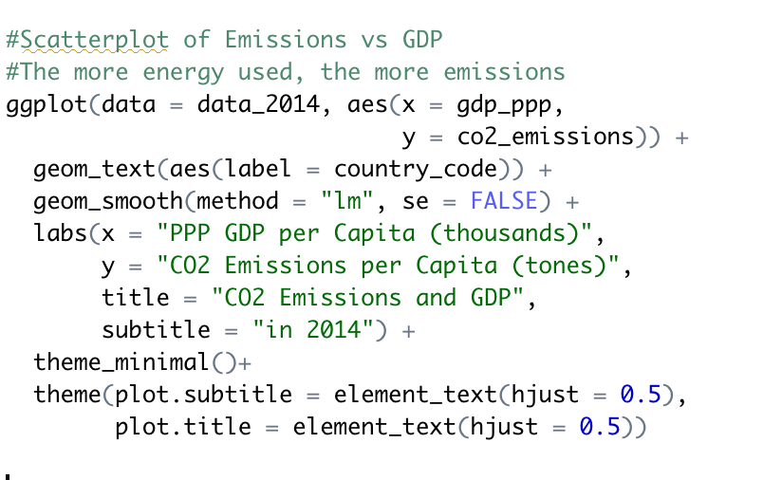

Slide 37
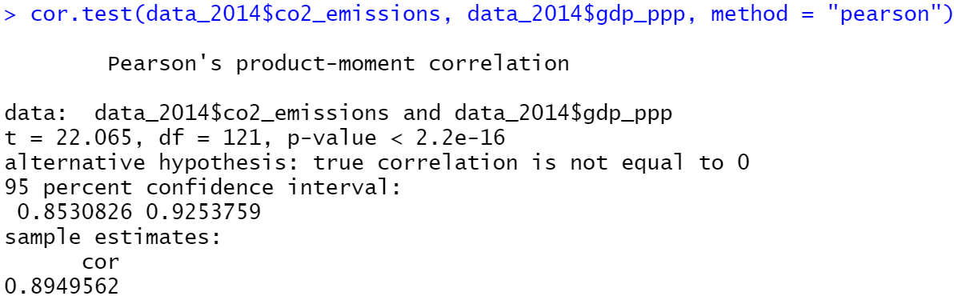
Correlation Test

Slide 38
Summary of Correlation Tests
GDP and Energy Production
Correlation: 0.3296619
GDP and Energy Supply
Correlation: 0.650436
GDP and Energy Consumption
Correlation: 0.831357
GDP and Population
Correlation: -0.1093605
GDP and CO2 Emissions
Correlation: 0.8949562

